Slide 1

E-Commerce Customer Categorization and Analyzer
Leveraging machine learning and data analysis, this project uncovers customer behavior patterns and product categorization insights from one year of e-commerce purchasing data.

Slide 2

Project Overview & Purpose
Uncover Patterns
Actionable Insights
Optimize & Enhance
Analyze customer behavior and product categorization using advanced techniques.
Provide businesses with data-driven recommendations to optimize strategies.
Improve marketing efforts and product offerings based on findings.
Designed for learning, this project may contain errors and is open to improvements.

Slide 3





Key Features
Data Preprocessing
Behavior Analysis
Product Categorization
Handling missing and duplicate values for data integrity.
Detailed insights into customer actions and product performance.
Using NLP and clustering for effective grouping.
ML Models
Visual Storytelling
Customer segmentation and classification for targeted strategies.
Interactive and static visualizations for clear insights.

Slide 4

Technologies Powering the Project
Key Libraries
numpy: Numerical computations
pandas: Data manipulation and analysis
matplotlib & seaborn: Visualization libraries
scikit-learn: Machine learning algorithms and metrics
plotly: Interactive visualizations
nltk: Natural language processing tasks
Python
The core programming language for all development.

Slide 5

Dataset Overview: One Year of E-Commerce
This project analyzes a comprehensive dataset capturing one year of e-commerce purchasing behavior. It includes customer orders, product details, and transaction records, enabling a deep dive into trends and patterns.
Dataset Link: https://www.kaggle.com/datasets/carrie1/ecommerce-data

Slide 6
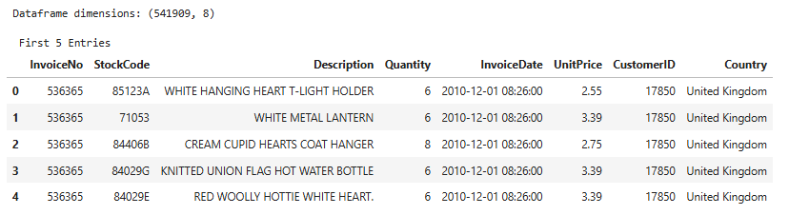
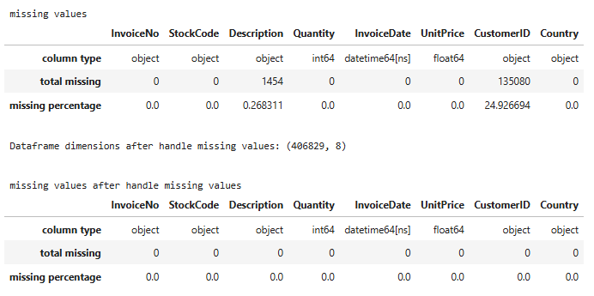
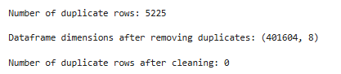
Data Preparation: Ensuring Quality
01
02
03
Data Loading
Handling Missing Values
Duplicate Values
Initial loading and checks for missing and duplicate values.
Identification and appropriate handling to maintain data integrity.
Removal of duplicate entries for accurate analysis.

Slide 7
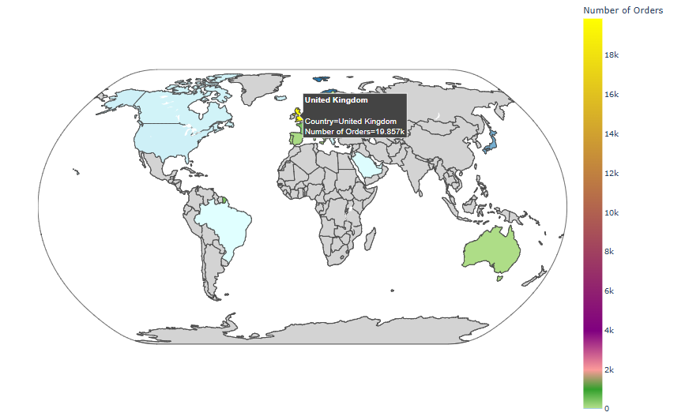
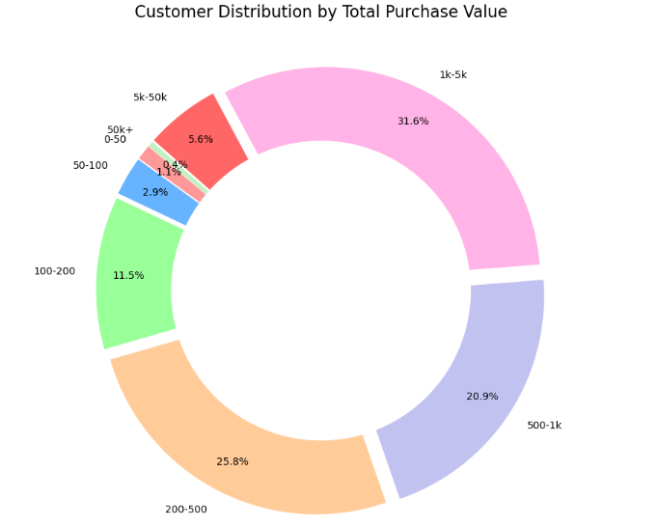
Exploring Variables: Global Insights
Analysis by Countries
Customer and order distribution are analyzed at the country level.
Bar charts for customer and order counts.
Choropleth maps for global order distribution.
Cancelled Orders
Transactions marked as canceled are filtered and analyzed for patterns.
StockCode & Basket Price
Unique StockCodes are examined, and a new 'Basket Price' variable is calculated.

Slide 8
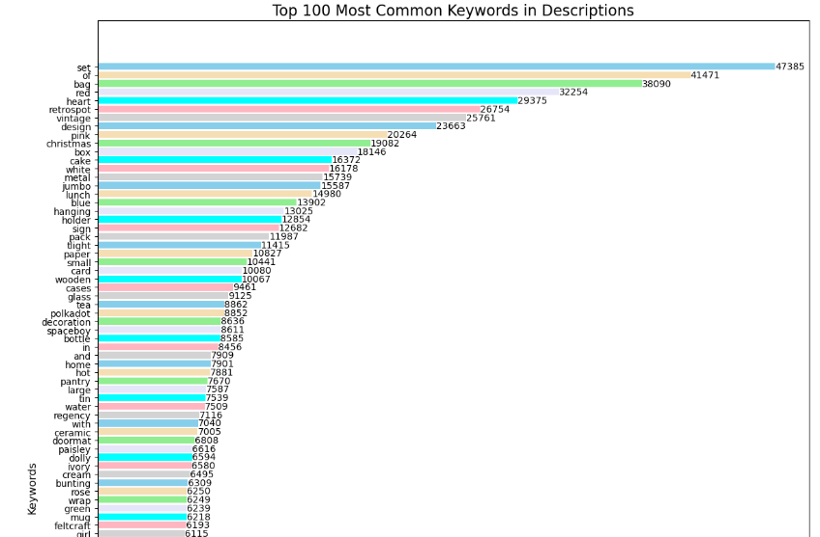
Product Description Analysis
1
2
Keyword Extraction
Data Encoding
Using nltk, 100 common keywords are extracted from product descriptions, with POS tagging identifying categorical keywords.
TF-IDF measures keyword importance, and binary matrices track keyword presence in descriptions.

Slide 9


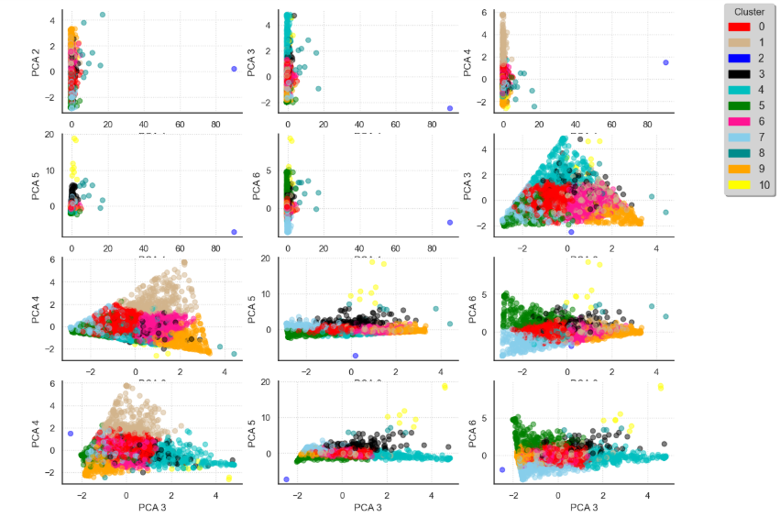
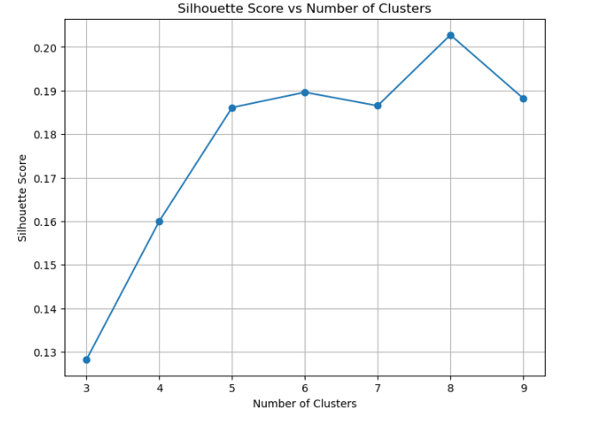
Creating Product Clusters
K-Means Clustering
Silhouette Score
Products are grouped into distinct clusters using the K-Means algorithm.
This metric helps determine the optimal number of product clusters.

Slide 10
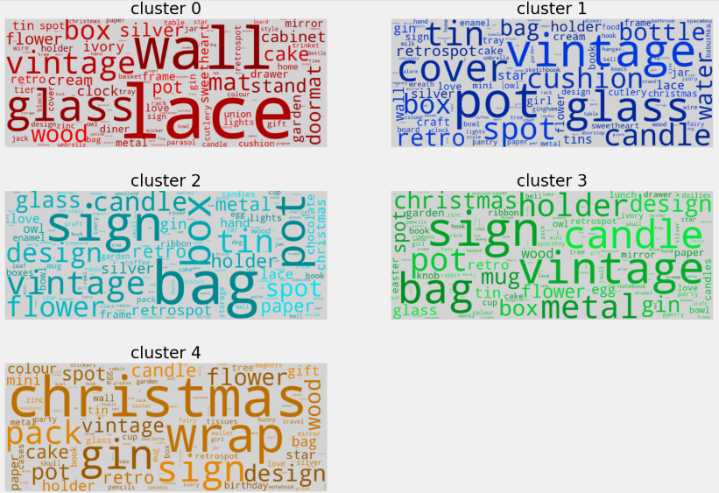
Creating Product Clusters (contd.)
Word Clouds
Visual representations highlight keywords for each cluster.

Slide 11
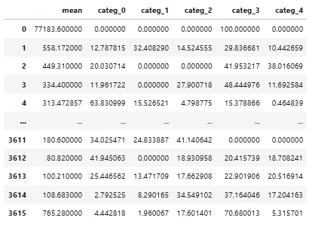
Defining Customer Segments
Customers are segmented based on their purchasing behavior to reveal distinct patterns. This includes:
Purchase Frequency
Average Spend
Total Lifetime Value
The number of transactions a customer makes over a period.
The mean amount spent per transaction by each customer.
The cumulative amount spent by a customer since their first purchase.

Slide 12

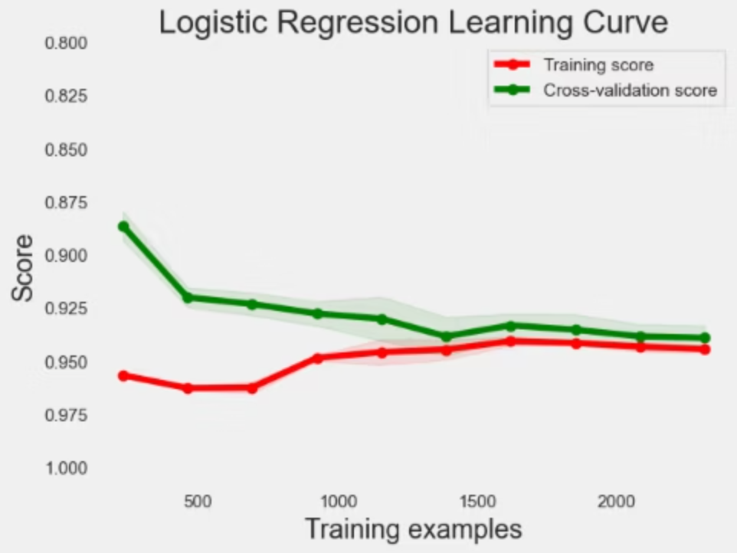
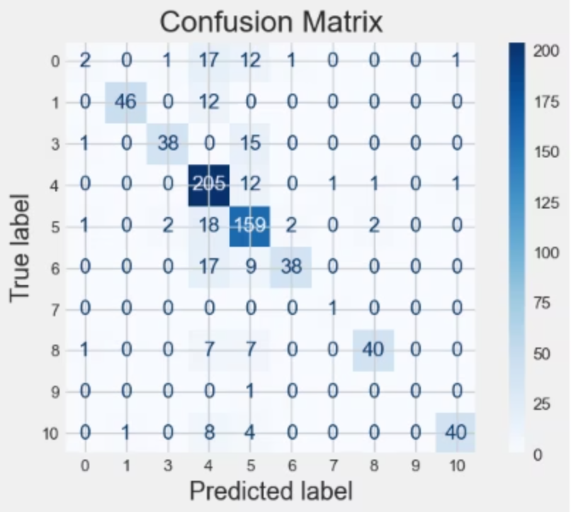
Classifying Customers: Our Methodology
Our classification process involves defining key features and implementing robust machine learning models for accurate customer categorization.
1. Feature Definition
3. Model Evaluation
X: Represents spending patterns across various product categories.
Performance is rigorously assessed using a suite of metrics:
Y: Indicates the assigned customer cluster.
2. Models Implemented
Support Vector Machine Classifier (SVC)
Logistic Regression
k-Nearest Neighbors (k-NN)
Decision Tree
Random Forest

Slide 13
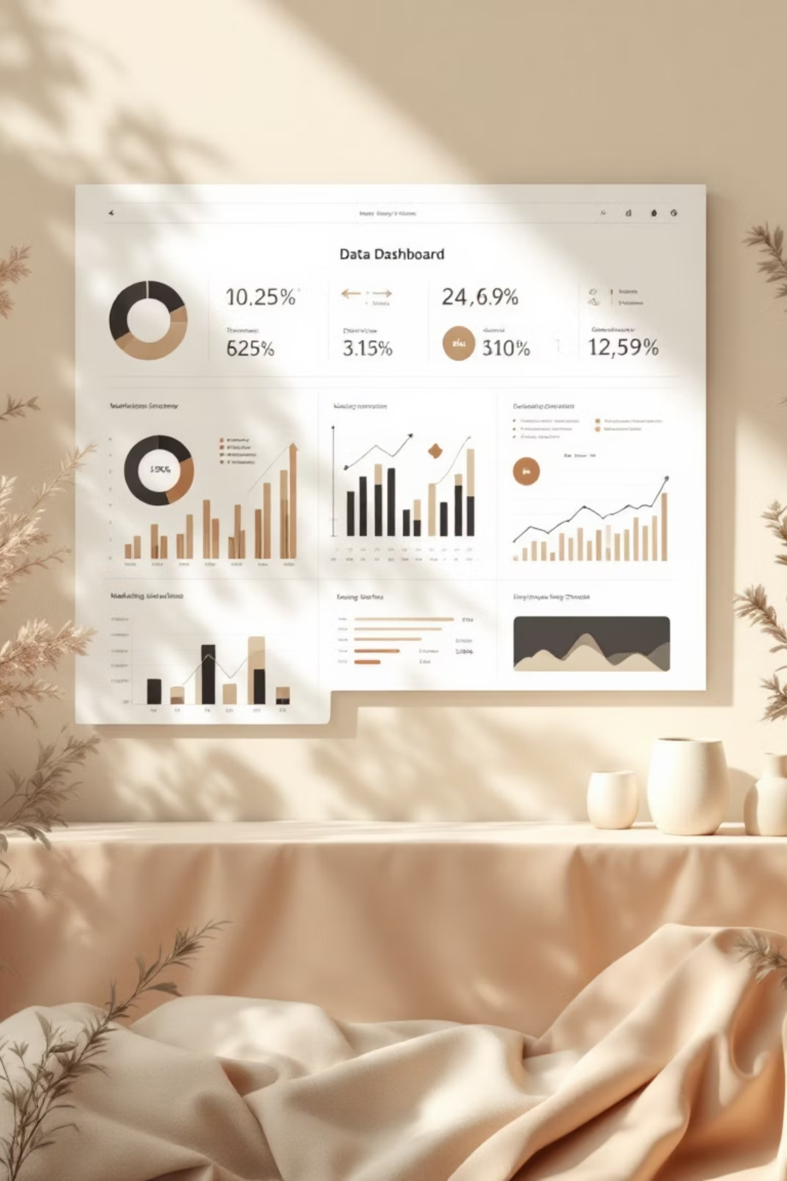
Visualizations, Insights, and Future Directions
Through comprehensive visualizations and actionable insights, our project paves the way for advanced e-commerce strategies.
Visualizations
1
Bar charts, choropleth maps, word clouds, and scatter plot matrices provide deep dives into customer data.
Key Insights
2
Effective clustering reveals distinct customer behaviors, while Logistic Regression demonstrates superior classification accuracy.
Future Advancements
3
Further work will focus on optimizing model performance, refining product clusters, and implementing advanced ML techniques for even deeper insights.

Slide 14



Conclusion: Paving the Way for Data-Driven E-commerce
The E-Commerce Customer Categorization and Analyzer project successfully demonstrates the power of clustering, keyword extraction, and machine learning to unlock valuable customer insights. This analytical framework establishes a robust
foundation for strategic decision-making and continuous improvement.
Actionable Customer Insights
Foundation for Growth
Future Advancements
Providing clear, data-backed understanding of customer behavior for targeted marketing and product development.
A scalable analytical framework that supports continuous customer understanding and predictive modeling.
Opening avenues for model optimization, product cluster refinement, and the implementation of advanced AI techniques.

Slide 15
Thank You

